Slide 1
3D Modelling
Sanith
Anudeep
Guide: Vijay bhaskar

Slide 2


Languages used
Notes:
Some features of HTML5 are used and CSS3

Slide 3


Languages used
+
SQL server
Razor
Notes:
SQL server is used for database and Razor syntax is used as server side scripting lang.
Razor is an ASP.NET programming syntax used to create dynamic web pages with the C# or Visual Basic .NET programming languages.

Slide 4
What our site actually does?
Receives complaints/feedback from students
Stores them in a database
Display all the complaints to the students

Slide 5
3 main things
Name
Department
Complaint
Email
optional
Notes:
Anudeep will explain from now.(from next slide)

Slide 6
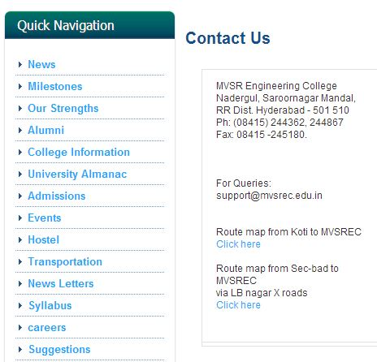
Nobody knows that there is one!!
Notes:
We checked whether our college has a facility to receive complaints, it turns out that there is an email id associated for queries!
Sad thing about this is nobody in our college knows about this and some doesn’t want to reveal their identity so they wont email!
The solution for this is to create a separate site for complaints and to display the complaints publicly so that they wont be neglected

Slide 7
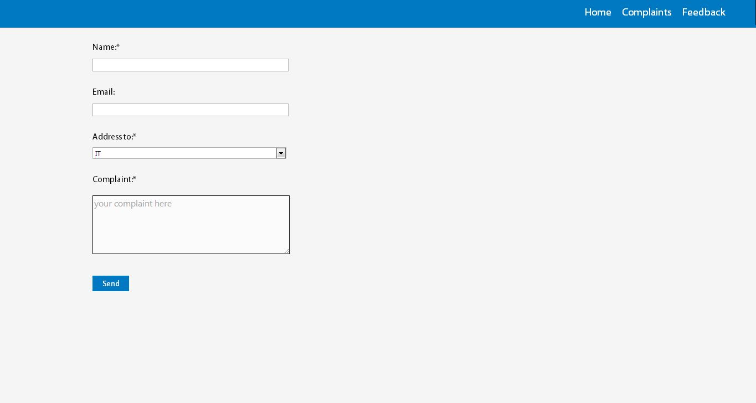
Notes:
Home

Slide 8
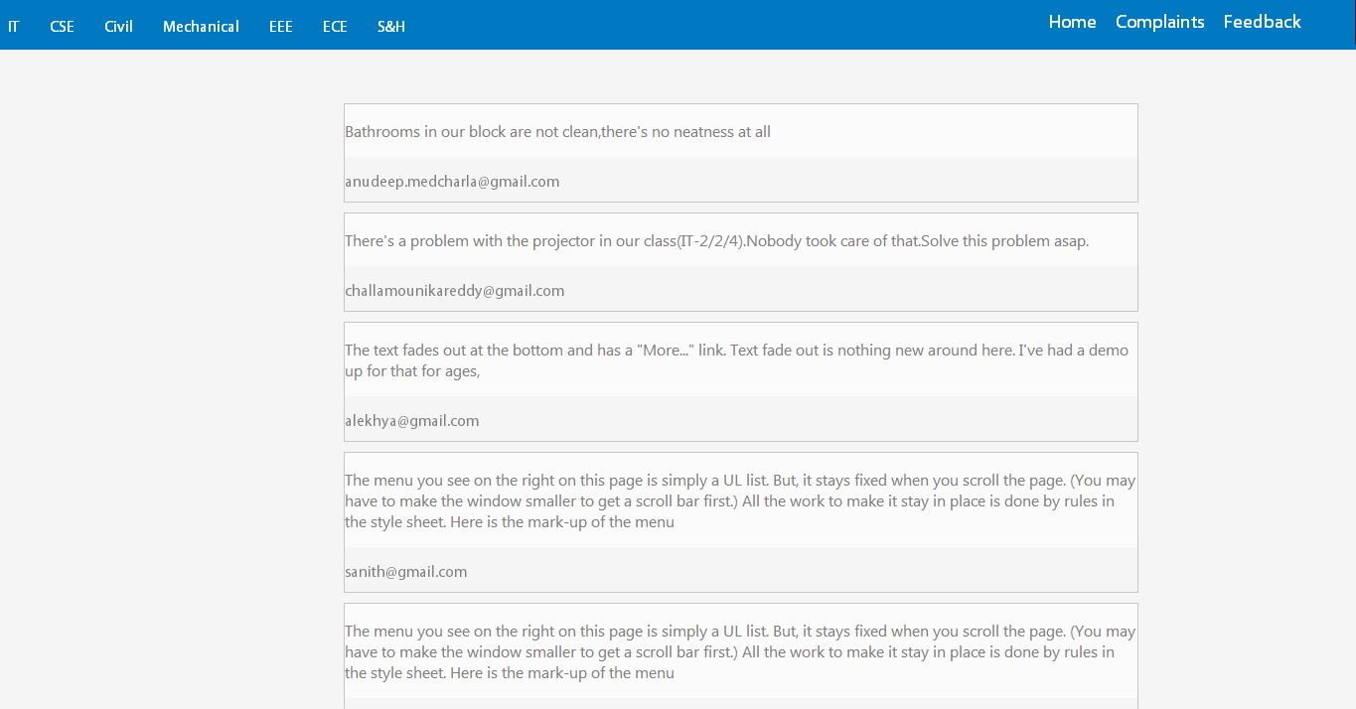
Notes:
Complaints page.
Even though some wanted to create a site, they don’t apply a good design to their site. they use templates to solve that problem, templates are filled with all type of junk and unnecessary styles.
We tried to keep our site as simple as we could(so only 3 mail fields to be entered)
Its simple yet beautiful.

Slide 9
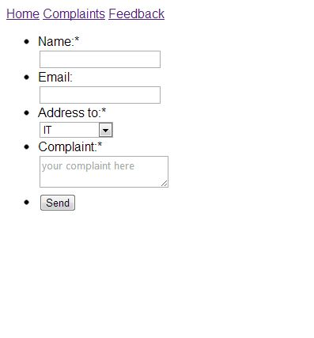

Slide 10
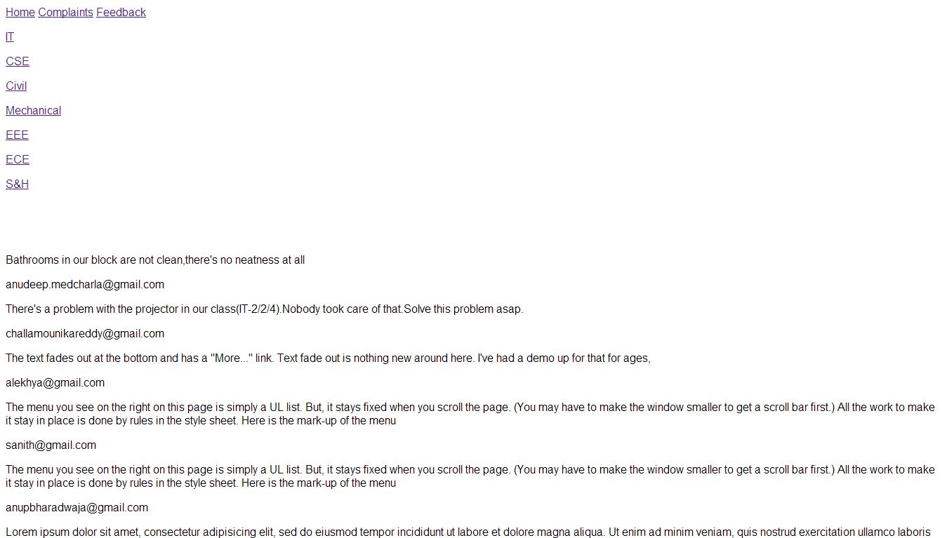

Slide 11
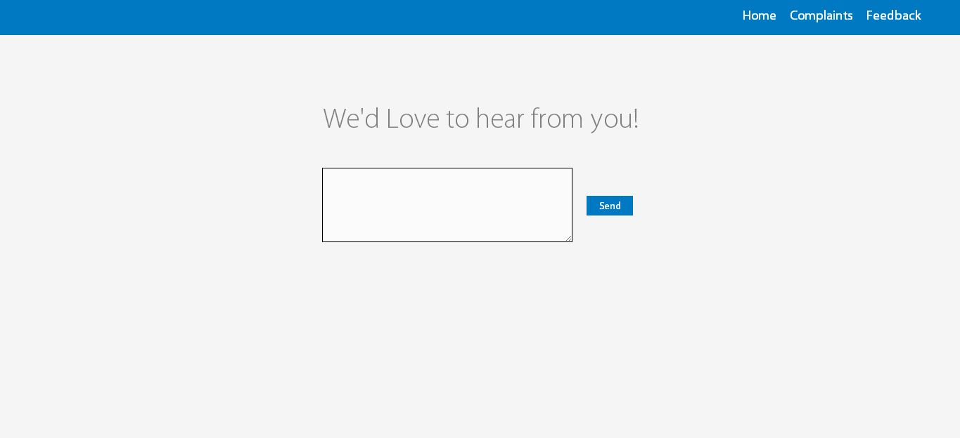

Slide 12
Simplicity
<!--Leonardo da Vinci-->
is the ultimate sophistication

Slide 13
Thank You!

